Slide 1

GCP DATA ENGINEER REVIEW

Slide 2
Google Cloud Platform Service | Service Function | Certification Weight | Mastery
Cloud Storage | Unified object storage | 2 % | OK
Cloud SQL & Spanner | Fully-managed SQL Database | 4 % | OK
Cloud Datastore | NoSQL database (think adhoc storage) | 2 % | OK
Big Table | NoSQL massive data big data service | 16 % | OK
Big Query | Petabyte scale data warehouse | 16 % | OK
Pub/Sub | Asynchronous messaging service | 6 % | OK
Cloud Dataproc | Managed hadoop and spark | 12 % | OK
Cloud Dataflow | Data Processing (Pipelines) | 16 % | OK
Tensorflow | Machine learning language | 20 % | OK

Slide 3
Storage and databases
Use | Services Like | Use case | Structure | When ? | IAM
Cloud Storage | S3 , HDFS | - Object-unstructured - Unstructured data holds everything - Archiving data for low cost | - https//FQDN (unique) and hierarchical. | - Storing media, blob storage - Multimedia, analytics, DRP. | ACL
Cloud SQL | RDBMS (MySQL and postgres) | - RDBMS < 10 TB - Structured data with acid properties. Vertical scaling even with read replicats. High Availability with automatic replication and failover. | - Datase, tables, colums, rows, PK (unique ID) - Indexes | - OLTP - ACID | Project, Instance and database
Cloud Spanner | RDBMS distributed highly scalable | - RDBMS > 10 TB Global. - Horizontal scaling with high transactions consistency (no trade-off) - High Availability with automatic replication and failover. | - Datase, tables, colums, rows, PK (unique ID) Strong Typed schema (database and schema have data types) - Interleaved tables with indexes - One mandatory PK + only one other index max. | - Distributed OLTP - ACID ++ (typed schemas) | Project, instance and database
Cloud Datastore | MongoDB, CouchDB (KV/ indexed db),dynamo (doc) | - NoSQL/ No Ops /High Scalable. - Hierarchical Highly Structured document DB. - Multi-region or regional. - Only one datastore by project. - Query execution depends on size of returned result, not size of dataset | - Instance, category of object Kind (table), one object entity (row), individual data for an object property (column), Unique ID for an object Key (PK) - SQL Query : No joins/filtering subquery, Only one inequality - Composite indexes - All is indexed by default you can exclude from index to speedup. | - Document DB, NOSQL - Strongly (ACID) or Eventually consistent | Project, Instance or database
Big Table | Hbase ,cassandra, dynamoDB (columnar DB) | - No-ops, NoSQL, low latency, Columnar fast-scanning unique KV. - (eg: graph, IoT, Finance) - Data > 1TB to hundrer of PB and each item < 10 MB - Handles Milions ops/sec.(cheap for very frequent access) | - 4-Dimensional: row key, column family (table name), column name, timestamp - No index on tables (only one row key per rows) - Data is stored, ordered lexicographically and indexed by rowkeys - SQL queries not supported | - NOSQL (ACID row level) - Time-series, Marketing, Financial, IoT and Graphs. - Time-series data, use tall/narrow tables. | Project and instance level. Restrict with application
Big Query | Hive (SQL like but map reduce on hdfs) | - Analytics/DWH (OLAP DB) - Few or batch imports and need fast reads at PB scale. | dataset/tables or views/columns/rows _PARTITIONTIME as pt + clustering Exporting/importing/copying data is free (not for streaming) | - Analytics/DWH (OLAP DB) | Organizations, projects, and datasets

Slide 4
BIG data and ML
Use | Srvs Like | Use case | Structure | When ? | IAM
PUB/SUB | Kafka | Balancing workloads in network clusters Asynchronous order processing Distributing envent notifications | - Message -> topic (message store)-> subscription -> message to subscriber -> ack to subscription | - Data ingestion and event processing | PROJECT, TOPIC, SUBSCRIBTION
Dataflow | Beam | Ingest stream or batch or both at scale. This is the glue. Ingest at scale | - Driver, pipeline,element,transforms(eg: pardo), source and sink, runner | Need to bound data. unbounded data. - When new hadoop is needed. | Project level only Pipeline data & access
Dataproc | Hadoop, cloudera, hortonwork | Hadoop on prem Use Hadoop (MapReduce,YARN,HDFS), Spark, Hive and Pig | - Process data and extract it.(GCS is prefered with preemptible process only nodes if possible) - GCE at least 1 master and 2 workers - Can only change #Workers/preemptible VM’s/labels/toggle | - Need efficient low cost big data computing | clusters and jobs
Cloud ML | Tensorflow (distributed) | Fully managed TF (supports : Tensorflow, scikit-learn, XGBoost frameworks and Keras in beta) ML Research | On premise gcloud ml-engine local train Train model in Cloud ML Package it (model) Make online or batch predictions (return results) Can use BQ or GCS for data source (training app) | - Custom ML or ML not in Google APIs. | Project and models
GCP ML API’s | Pre-built machine learning models. | - Want to use pre fetched models without the ML work before. (plug and play) | -send data in encoded 64 bits and return a JSON file. | Quick solution Feet my case Can combine several | API access with key
Tensorflow | ML libary in python | Train for cloud ML and develop localy. ML research (best ML libary) | - DAG | - ML dev | N/A
Dataprep | Talend | - Only web service to prepare data (trifacta) | Cost 1,16 * Dataflow jobs Input :CSV JSON, TXT,CSV,log,TSV and avro. Output : CSV,JSON,Avro,BQ table (CSV/JSON GZIP) | - Use to prepare data | Project level + access to underlaying data
Datalab | Jupiter | - Jupyter hosted over GCE | GCE basic is free but you can customize it. Can create notebooks for users or Same shared notebook repository (eg: code repository) | - Great for data engineering/ ML | GCE instance admin and Service roles
Datastudio | Powerbi | - Visual reports/dashboards | Hosted in google drive and free. Can cash data and use prefetch caching | - Share datavize | Share a data acces + report

Slide 5

Google Cloud Storage & Transfer

Slide 6
 | GCS Google cloud Storage |  | Persistent Disk |  | Local Persistent disk
Usage | Buckets to store objects/Blobs. Virtualy Unlimited storage Ideal for storing but not for high volume of read/write (e.g. sensor data) Commonly used by Dataproc and BigQuery as storage. |  | HDD & SDD storage shareable through VMs/containers. Good for snapshots of data backups/sharing read-only data across VMs. |  | HDD & SDD storage added localy. For high throughput and very low latency.
Attributs | Globaly unique Name Storage class (Multi-regional, Regional, Nearline & Coldline) Encryption at rest by default. |  | Encrypted at rest. Low cost, redudancy. |  | High cost High performances and very low latency. No availability and redundancy.
GCS specific attributs | Multi-regional or regional | Nearline & Coldline |  | Encryption
 | High availability and performances. Provides global access to data . | Nearline : For once a month Coldline : For once a month ~1 sec lookup for access, charged for volume of data accessed |  | Customer supplied encryption keys (created and managed for server-side) Customer managed encryption keys (create and managed using KMS) Client side encryption (encryption before send it to google).

Slide 7
Storage Transfer Service | Import online data into Cloud Storage. Repeating schedule Transfer data within Cloud Storage, from one bucket to another. Source: GCS, S3, URL
Transfer appliance | One-time Rack, capture and then ship your oﬄine data to Google Cloud.
Gsutil Copy | If you have a large number of ﬁles to transfer you might want to use the gsutil -m option, to perform a parallel (multi-threaded/multiprocessing) copy. From on-premise to GCS.
Best Practices | Compressing and combining smaller ﬁles info fewer larger ﬁles is also a best practice for speeding up transfer speeds.
Avro Data Format | Is faster to load. The data can be read in parallel, even if the data blocks are compressed. Doesn't require typing or serialization. Is easier to parse because there are no encoding issues found in other formats such as ASCII. Compressed Avro ﬁles are not supported, but compressed data blocks are. BigQuery supports the DEFLATE and Snappy codecs.

Slide 8
Cloud SQL

Slide 9


 | Cloud SQL
Database Settings | Full managed Mysql MySQL 5.6 or 5.7 (Gen 2) up to 416 GB of RAM and 10 TB data storage |  | Fully managed PostgreSQL 9.6 10TB of storage capacity, 40,000 IOPS, and 416GB of RAM per instance
Shared chars | US, EU, or Asia + Multi-Zone Managed RDBMS service like RDS: OS installation/management, Backups, Scaling – disk space. Availability: Failover Read replicas Monitoring Authorize network connections/proxy/use SSL Limitations: Read replicas limited to the same region as the master : Limited global availability. Max disk size 10 TB Can’t have SUPERUSER privileges + other few features. | Security
 |  | - Customer data encrypted on Google’s internal networks and in database tables, temporary - files, and backups. - Support for secure external connections with the Cloud SQL Proxy or with the SSL/TLS protocol. - Support for private IP (private services access). - Data replication between multiple zones with automatic failover
Import/Export | Importing in cloud SQL: Cloud Storage staging SQL Dump/CSV Export/import process: Export SQL dump/CSV file (can’t contains triggers, views, stored procedures) Get dump/csv file into GCS and import into Cloud SQL instance. Best practices: Compress data to reduce costs as Cloud SQL can import .gz files. Use Innodb for second generation.
SQL Best practices | Try to keep tables small and normalized. Ban select * Use innerjoin instead WHERE clause.

Slide 10
Cloud Spanner

Slide 11
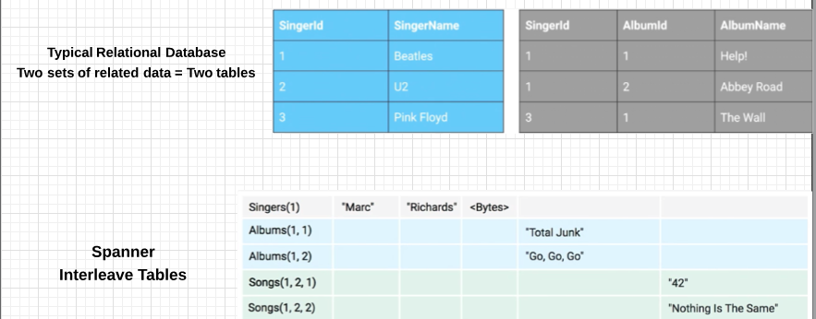
 | Use Case | Don’t Use
Cloud Spanner | Need High Availability. Strong Consistency. Transactionnal reads and writes. Recommended 3 nodes in production. | Data is not relational or even structured. Want an open source RDBMS. Strong consistency and availability is overkill.
Data model | Databases contain tables. Tables « look » relational – rows, columns and strongly typed schemas.
Parent-child | Parent-child relationships between tables. These cause physical location for fast access. Data locality will be enforced between 2 independent tables. Every tables must have primary keys. To declare table is child of another… Prefix parents’s primary key onto primary key of child. Storage model near from Hbase.
Interleaving | Rows are stored in sorted order of primary key values. Child rows are inserted between parent rows with that key prefix. Interleaving provides fast sequential access like Hbase.
Hotspotting | Choose your primary key wisely. Instead of monotonical ordered keys, use hash of KV. This will use different storage location and increase speed using data splits.

Slide 12
Splits | Parent Child relationships up to 7 layers. CloudSpanner is distributed uses splits. A split is a range of rows that can be moved around independent of others. Splits are added to distribute high read-write data (to break up hotspots)
Secondary indexes | Hbase-like KV storage for fast sequential key scan. A secondary index can be also added (be careful of redundant data) We can force query to use a specific index with index directives. We can also force a column to be copied into a secondary index with storing clause.
Data Types | Strongly-Typed (schemas have types) Arrays and Struct available. STRUCTS are not OK in tables. ARRAYS are OK in tables but ARRAYS of ARRAYS are not.
Transactions | Supports serializability. Transaction support is super-strong. Transactions commit in order. Two transaction modes (R-W (slow) & R-Only (fast)) If making a one-off read, use something known as “Single Read Call”. Fastest, no transaction checks needed.
Staleness | Can set timestamp bounds. Strong (the default): read the latest data. Bounded staleness: read a version of the data that's no staler than a bound. Exact staleness: Read data state from a timestamp in past or future.
Tools | gcloud spanner instances create [INSTANCE-ID] --config=[INSTANCE-CONFIG] \ --description="[INSTANCE-NAME]" --nodes=[NODE-COUNT]
Security | IAM : Project / instance or DB level. Roles spanner Admin

Slide 13
Cloud Datastore

Slide 14
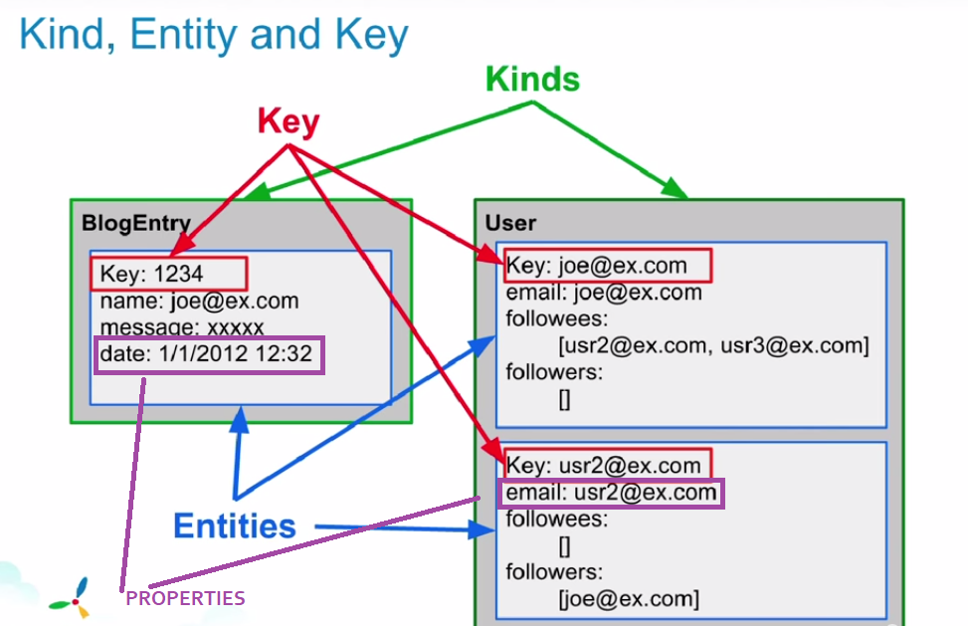

Slide 15
Concept | Relational database | Cloud Datastore | Cloud Firestore (New*)
Category of object | Table | Kind | Documents
Individual data for an object | Column | Property | Column
One object | Row | Entity | Collections
Unique ID for an object | Primary key | Key | Primary key
Metadata Structure | Structured relational data | Structured hierarchical data (XML,HTML)
Properties | Rows of table have the same properties | Entities of a kind can have different properties
Types | Types of all values in a column are the same | Types of different properties with same name in an entity can be different
Joins | A lot | No joins
Filters | Filtering on subqueries | No filtering on subqueries
Inequality filter | Multiple | Only one inequality filter per query
Query execution time | Depends of the dataset size + dataset results | Depends only on results size
Firestore is the new Datastore re-brad name with a native mode (new version) and datastore mode (old one). New features: A new, strongly consistent storage layer A collection and document data model Real-time updates Mobile and Web client libraries

Slide 16
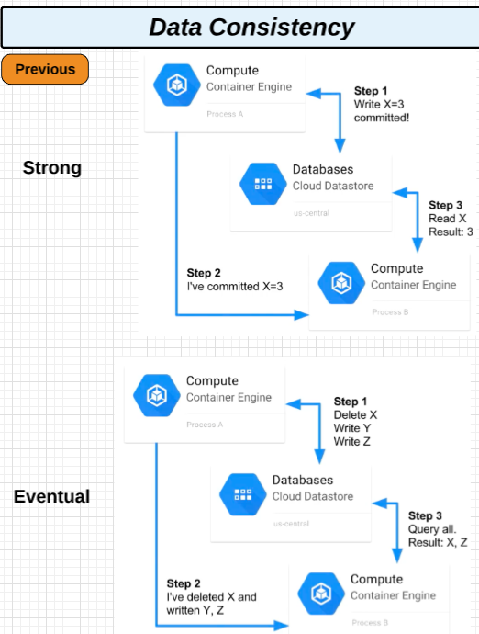
Full indexing | « built-in » Indexes on each property (field) of each entity kind (table row). Compostire indexes on multiple property values. We can explicitly exclude a property from indexing.
Perfect indexing | Query engine find the best optimally returns query results. Depends on the following in order: Equality filter. Inequality fiter (only 1 allowed). Sort conditions if any specified.
Implication of Full indexing | Updates are really slow. No joins possible. Can’t filter results based on subquery results. Can’t include more than one inequality filter.
Multi-tenancy | Separate data partitions for each client organization Can use the same schema for all client, but vary the values Specified namespace (where each kind and entities can exists)
Transaction support | Can optionnaly use transactions. Not as strong as cloud spanner (ACID ++) or Cloud SQL (ACID), but stronger than Big Query or big Table.
Consistency | Two consistency levels are possible for query results Strongly consistent : return up-to-date result, however long it takes Eventually consistent : faster, but might return stale data
Usage | Does | Don’t use
 | Use for crazy scaling of read performance. (depends on result size) and regional or multi. Hierarchical documents with K/V. Ideal for « needle-in-a-haystack » type applications. (Lookups for non-sequential keys) Data structure with a constant lookup time (hash table) | For Very strong transaction support (Cloud spanner instead) For non-hierarchical or unstructured data (Bigtable instead) OLAP/BI/DWH -> (Big query instead) For immutable blob movies each > 10 mb (Cloud Storage instead) If application has lots of writes and updates on key columns.
Tools | API in a lot of langages (ex python): from google.cloud import datastore def …

Slide 17
Big Table

Slide 18
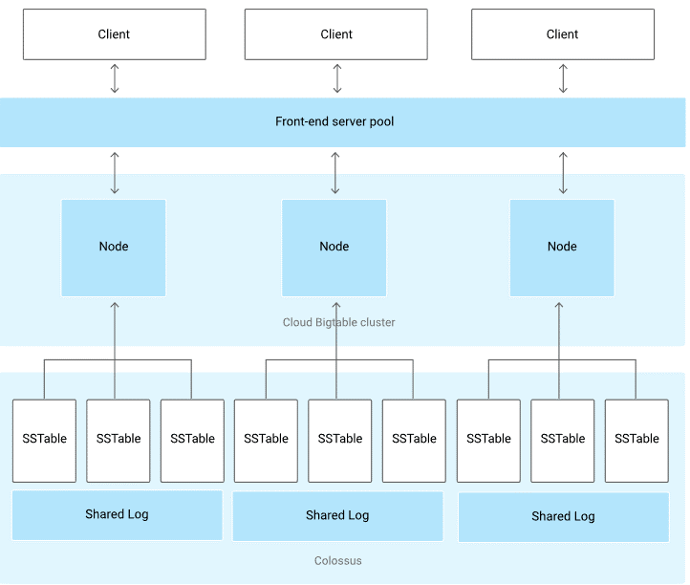
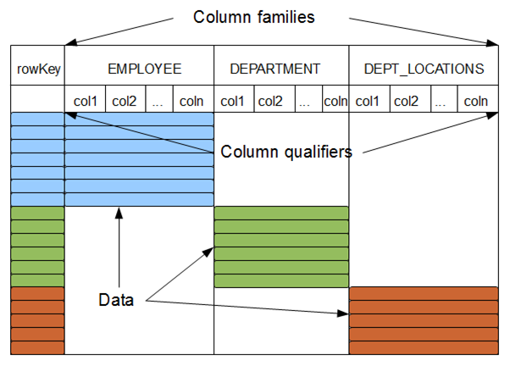
Schema and design
Sparse tables : Each empty field take no more storage space. Every time a value change in a cell, this is associated to a timestamp. Read a single record should get all the details in one read operation.
Row keys : Row key is the only index so quering anything else = full scan. Row key determines grouping for reads and writes Identical chunks of data on adjacent rows are compressed. Short row keys take up less memory and storage > faster response time.
Column families : Column are stored together, accessed together and cached together. Group them according your MCD. If you query all the columns all the time choose only one column family. Column family add will need to be rebuild the table and new columns can be added on fly.
Designing Row Keys : Avoid hotspotting: Field promotion : Move a data field to the beginning of the row key. Salting: Add a bit of salt (number) to each key for each node. Work if you don ’t scale up (add more nodes). Hash function: Apply to timestamp and use hash at start of key Work if you query a single row. Eg hash on a UsernameFollower field (always the same lenght): 1d02e347a52b0c4f Reverse Domain names: Reverse them to get them grouped. Prefix + timestamp: - Avoid put a timestamp alone or in a suffix for row key (eg: MICHAEL-20150608123456).
Recommended Limits : Row keys : 4 KB per key Column families ~100 families Column qualifiers 16 kb per qualifier Individual values ~ 10 MB per cell All values in a single row :~100 MB | Hard limits : Individual values : 100 MB per cell All values in a single row : 256 MB 1000 tables per cluster | Tools : Recommended by google CBT. Alternativly : Hbase Shell

Slide 19
Cluster configuration
Performance Storage/node with no scale loss |  | Reads |  | Writes |  | Scans
SSD |  | 10.000 QPS @ 6MS |  | 10.000 QPS @ 6MS |  | 220 MB/S
HDD |  | 500 QPS @ 200 ms |  | 10.000 QPS @ 50 MS |  | 180 MB/S
HDD usage: Cost is 15% of SSDs, but extra nodes more costly. If > 10 TB of data, not sensitive to response time, batch scans and writes. Can’t switch HDDs to SSDs you need to export on cloud storage create a new cluster and then migrate.
Poor performances: Choosing poor row keys Using HDDs Small workloads Too few nodes Monitoring through Stackdriver monitoring or in console Up to 20 minutes after adding nodes before improvement Development instance only has one node that you can upgrade to production later. Network issues Clients should be in same zone as Bigtable cluster. |  |  | Load Balancing : Auto manages splitting, merging and rebalancing data. Master pep-rocess balances worload/data volume within the cluster. The master splits busier/larger tablets in half and merges less accessed/smaller tablets together, redistributing them between nodes Best write performance can be achieved by using row keys that do not follow a predictable order and grouping related rows so they are adjacent to one another, which results in more eﬃcient multiple row reads at the same time.
 |  |  | IAM @ project level only Applies only to GCP users with access to bigtable Limit end-user access through your application
Reader | User |  |  |  | Admin
Read Tables & monitoring graphs. | Write access to Tables Read access to monitoring graphs |  |  |  | Full access to Everything Incl. Creating new instances.
Does |  |  | Don’t
Very fast scanning and high throughput Use of Non-structured key/value pairs. Each data item < 10 Mb and total data > 1 Tb. Writes infrequent/unimportant (no ACID) but fast scans crucial. Use for time series data. Resides in one zone. Cheap for very frequent access. Each row/column contains timestamps records that can be accessed when the data has been altered over time. |  |  | Use if SQL needed (use cloud SQL or Cloud Spanner instead). Use for data less than 1 TB (can’t parallelize). Use for analytics/BI/DWH – Use BigQuery instead Use for documents or highly structured hierarchies – Use Datastore instead. Use for immutable blobs like movies each > 10 MB – Use Cloud Storage instead.

Slide 20
Big Query

Slide 21

Big Query is a fully managed DWH with service with his own storage adversly to Hive.
Data Model :
Project
Dataset(s)
Schema(s)
Table(s)
Table Types :
Natives (BG storage) | Externals (Big Table, Cloud storage …) | Views (unmaterialised)
Schema auto-detection:
While loading data and querying external data using a random file and read 100 rows.
Nested Fields:
We can access them using indexes and we can unnest them with 2 functions.
 | Batchs | Streaming | Alternatively
Loading data | AVRO/ PARQUET / Datastore Backups on GCS, ORC, Google sheets, csv, json(newline delimited) | - High volume event tracking logs - Realtime dashboards | Public datasets Shared datasets Stackdriver log files (export)
Export data | - CSV(default format) / Avro / Json (Gzip compression) - Note can only export 1Gb max by files so you have to split it using ‘*’ in the output name.
Read | - Google drive, big table, csv, json(newline delimited), GCS. - Dataflow (streaming)

Slide 22
 | Ressources
Tables | - Natives (BQ storage) - Externals (Big Table, Cloud storage …)
Views | - Views are logical and underlying query will execute each time view is accessed (billing) - Can’t assign access control (based on user running view) - Can’t mix standard and legacy (eg standard SQL query can’t access legacy view) - No UDF and No Wildcard table references allowed - Limit of 2500 authorised views per dataset
Paritioned tables | - Special table with auto partition & BQ create automatically date partitions. - Manual partitioning = performance descrease - Need to declare table as partitioned at creation time - No need to specify schema (can do while loading data) - Limit of 2500 tables per query doesn’t apply her
Slots | - Unit of computational capacity needed to run queries - Big Query calculates on basis of query size and complexity - Usualy default slots sufficient - Might need to be expanded for very large & complex queries - Slots are subject to quota policies - Can use StackDriver Monitoring to track slot usage

Slide 23
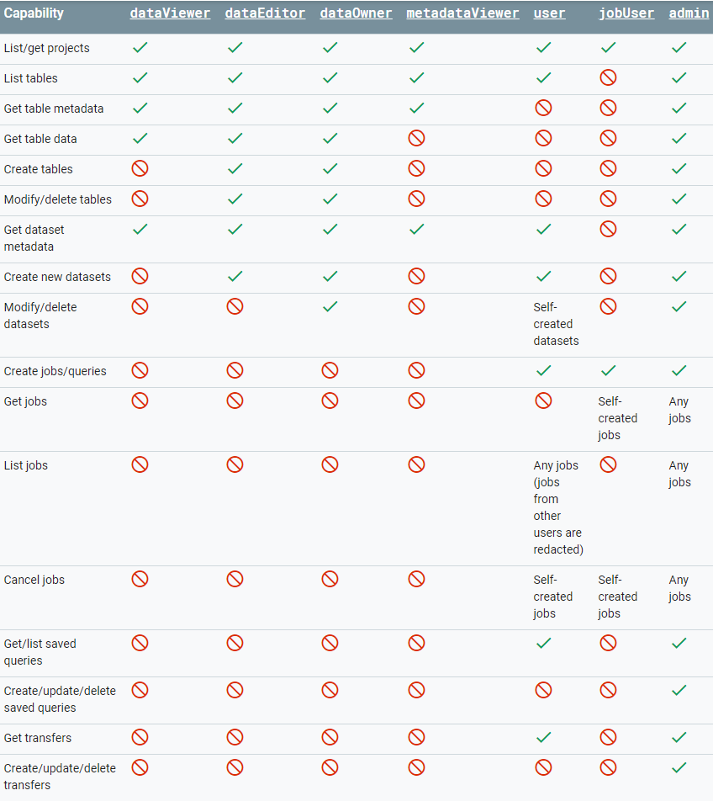
Access Control
Organisation
Project
Dataset
Datasets are child resources of projects.
Tables and views are child resources of datasets
— they inherit permissions from their parent dataset.
Views are like tables, you have the same rights on a table.

Slide 24
Query settings | Description
Destination | Allow you to write results in another dataset/table.
Resource managment | Interative (default) or batch (workaround BQ limits).
SQL Dialect | Standard or Legacy SQL.
Cache preference | By default BQ will cache all queries with referenced tables unmodified during 24 Hours. If you rerun the same query you will not be charged. Caching is per user only !
Processing Location | You can change location for BQ service.
IAM | Project, dataset, views Can’t manage at table level.
Performance colors | Wait read compute write

Slide 25
Costing | Active (Data stored in tables and modified in the last 90 days) | Long-Term (Data stored in tables and not been modified in the last 90 days)
Storage | $0.020 per GB + first 10 GB is free each month | $0.010 per GB + first 10 GB free each month
Streaming Inserts | $0.010 per 200 MB Charged for rows that are successfully inserted. Individual rows are calculated using a Min 1 KB.
Free operations | Load Data, Copy, Export, Delete, Metadata operations and read pseudo columns or metatables
Queries (analysis) | On-demand query pricing (default). | Flat-rate pricing is also available for high-volume customers.
Queries details | You aren't charged for errors, or cache queries. Charges are rounded to the nearest MB, Min10 MB processed by table and min10 MB per query. Cancelling a running query job may incur charges up to the full cost for the query were it allowed to run to completion. You're charged according to the total data processed in the columns you select | Applies only to query costs, not for storage. See Storage pricing for storage costs. Applies to all projects that are linked to the billing account where flat-rate pricing is applied. Provides additional BigQuery slots. See the following table for details. Provides additional query concurrency for interactive queries.
Queries costing | $5.00 per TB and First 1 TB per month is free | Monthly cost | Number of slots | Additional slots
 |  | $40,000 | 2,000 | $10,000 +500 slots

Slide 26
Controlling Costs | Description
Ban select * | Allow you to write results in another dataset/table.
Sample data | Use to preview button in BQ or use BQ Head n-10
Price queries before run | Look at estimator cost or run with –dry_run flag in cli
Limit bytes billed | --maximum_bytes_billed=1000000
LIMIT doesn’t affect cost | If you type limit 1000 you will not affect cost (you will billed for all data)
View cost | Use dashboard & audit logs to see your BQ cost and adapt your usage. https://cloud.google.com/bigquery/audit-logs
Partition data by date | use the _PARTITIONTIME pseudo column to filter for a date or a range of dates
Materialize query results in stages | Avoid to re-query your entire dataset. Only relaunch the last little query.
Default table expiration | Delete a table after X days of creation
Use streaming inserts with caution | There is no charge for loading data into BigQuery. There is a charge, however, for streaming data into BigQuery

Slide 27
Pub / Sub

Slide 28
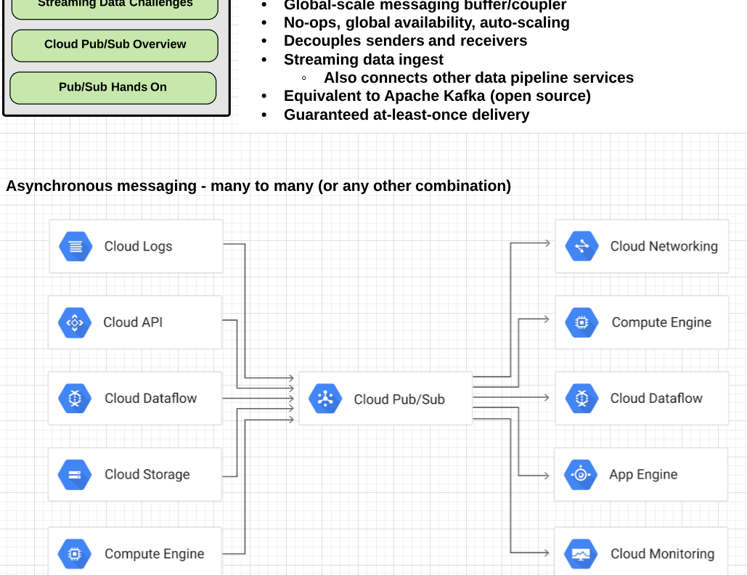
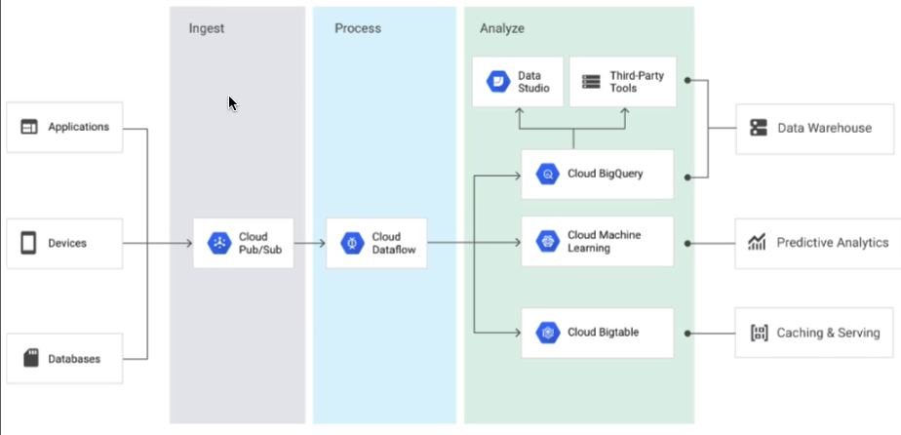
PUB/SUB | Global Messaging service that handles Streaming data. Many-to-many asynchronous messaging Decouple sender and receiver Streaming data = unbonded data = always flowing with no end. Gaurantees at least once delivery before deletion from queue.
Functions | Publisher apps create and send messages on a topic. Messages persisted in a message store until delivered/aknowledged. (7 days max) One queue per subscription. Subscriber apps subscribe to a topic to receive messages. Push – WebHook endpoint. Pull – HTTPS request to endpoint. (default) Subscription is a subscriber queue. Message = data + attributes sent by publisher to a topic. Message attributes = key-value pairs sent by publisher with message. By default subscription expires after 31 days if no activity. Once acknoledged by subscriber, message deleted from the queue. New subscribers can’t access old messages.
Use-cases | Balancing workloads in network clusters Asynchronous order processing Distributing envent notifications Refreshing distributed caches Logging to multiple systems simultaneously Queue can eﬃciently distribute tasks Implementing asynchronous workﬂows Data streaming from various processes or devices Reliability improvement- in case of zone failure

Slide 29
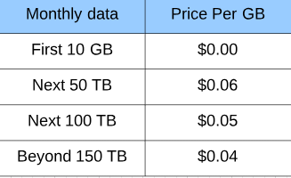
Pub/sub | Data place, which handles moving messages between piblishers and subscribers. Control plane, wich handles the assignment of publishers and subscribers to servers on the data plane. The servers in the data plane are called forwarders, and the servers in the control plane are called routers. We can add attributes like message source with K/V.
Publishers | Any application that can make HTTPS requests to googleapis.com App Engine app App running on a compute engine instance App running on third party network Any mobile or desktop app Event browser
Subscribers | Push subscribers – Any app that can make HTTPS request to googleapis.com Pull subscribers – must be WebHook endpoint that can accept POST request over HTTPS New subscribers can’t access old messages.
IAM | PROJECT, TOPIC, SUBSCRIBTION level Admin, Editor, publisher and subscriber. Service accounts are best practice.
Python | Git clone https://github.com/googlecloudplatform/python-docs-samples Import argparse From google.cloud import pubsub

Slide 30
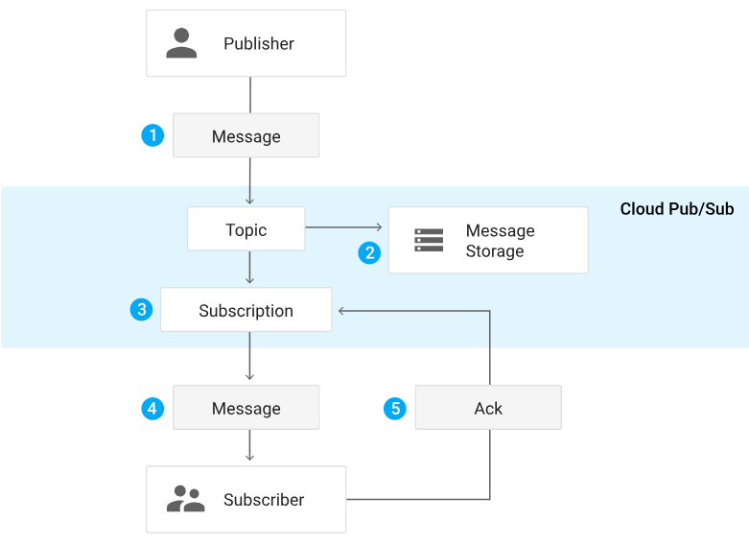
Message Life Cycle
Step | Description
1 | A publisher application creates a topic in PUB/SUB and sends messages to the topic. A message contains a payload (message body) and optional attributes that describe the payload content.
2 | Messages are persisted in a message store until they are delivered and acknowledged by subscribers.
3 | The PUB/SUB service forwards messages from a topic to all of its subscriptions, individually. Each subscription receives messages either by PUB/SUB pushing them to the subscriber’s chosen endpoint, or by the subscriber pulling them from the service.
4 | The subscriber receives pending messages from its subscription and acknowledges each one to the PUB/SUB service.
5 | When a message is asknowledged by the subscriber, it is removed from the subscription’s queue of messages.

Slide 31
Cloud Dataflow

Slide 32
Dataflow | Regional based - Transform data (etl) Use a DAG (Flink,Spark, Tensorflow…) can cancel or drain(gracefully) a job Based on apache beam (1.x) google created it before share it to apache fundation.
Driver | Driver : This initialisation defines computation DAG (pipeline)
Pipeline | Pipeline: Single potentially repeatable job, from start to finish, in Dataflow Encapsulates series of computations that accepts some input data from external sources, transforms data to provide some useful intelligence, and produce output. Defined by driver program: The actual pipeline computations run on a backend, abstracted in the driver by a Runner.
Element | Single entry of data (eg: table,file)
PCollection | Pcollection : specialized container classes that can represent data sets of virtually unlimited size in the pipeline. Fixed size: text file or BigQuery table. Unbounded: Pub/Sub subscription. Side inputs : injection of additional data into some Pcollection.
Transforms | Transforms takes one or more Pcollections as input, performs a processing function that you provide on the elements of that Pcollection, and produces an output Pcollection. The ParDo (do it in parallel) processing style is similar to what happens inside the "Mapper" or "Reducer" class of a MapReduce-style algorithm. What/Where/When/How ?
Source and Sink | Different data formats, such as files in Google Cloud Storage, BigQuery tables…
Runner | Runner executes DAG on a backend Beam supports multiple backends: Apache Spark, Apache Flink, Google Cloud Dataflow, Beam model, Direct Runner (local)
SDK’s | Java, Python (limitations for advanced functions), Go (basic functions).
IAM | @ Project level only (all pipelines in project) & Pipeline data access separate from pipeline access : Dataflow admin – full pipeline access + machine type/storage bucket config access. Dataflow viewer – view permissions only Dataflow worker – specially for service accounts.

Slide 33
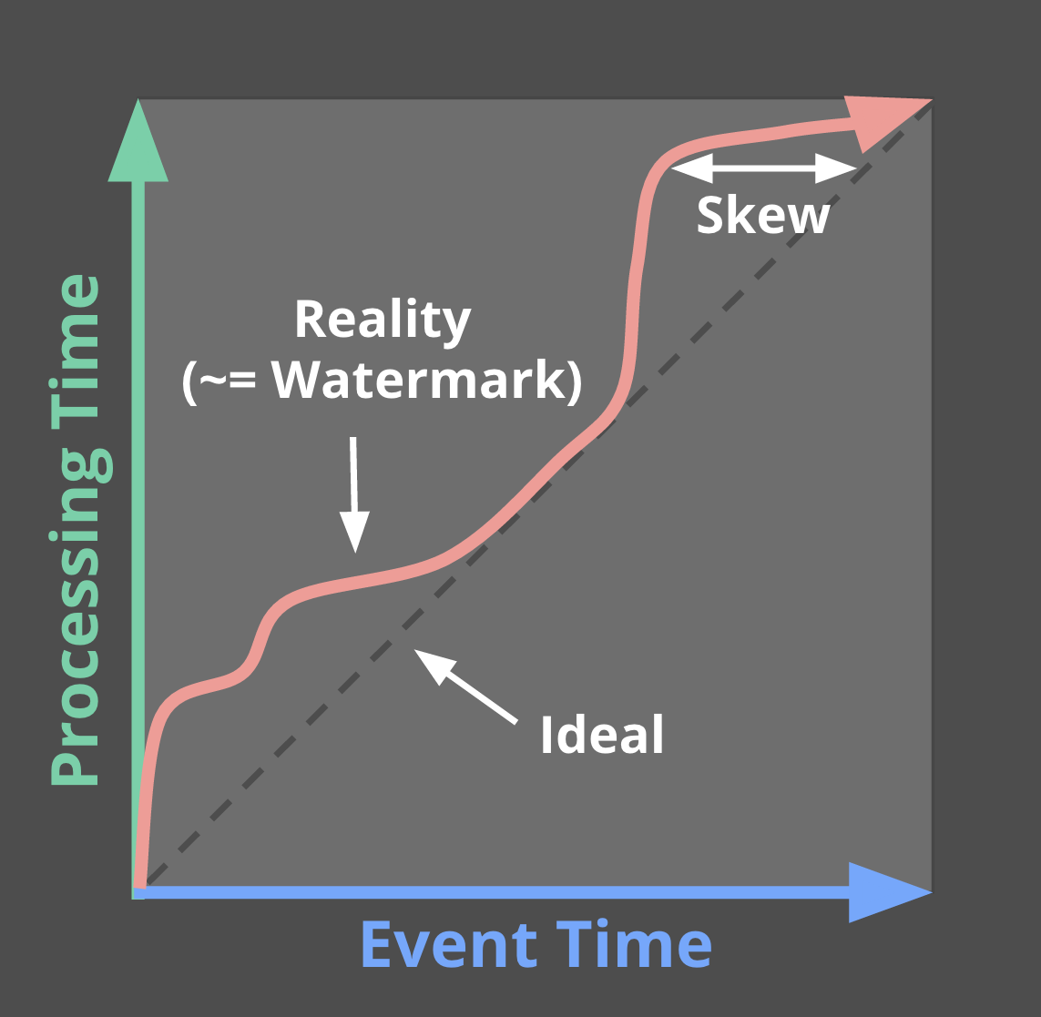
Event time = when the data occured
Processing time = when the data is inside the data pipeline
Watermarks describe event time progress.
Can use the pub/sub generated watermark or another source. "No timestamp earlier than the watermark will be seen"
Often heuristic-based.
Too Slow? Results are delayed.
Too Fast? Some data is late.
Formalizing Event-Time Skew
Notes:
Here the blue axis is event time and the green access is processing time.
In an ideal world, there’d be no delay between event time and processing time, so our elements would be processed right when they occurred, right along the dashed line. But reality looks more like that red squiggly line, where processing time is slightly delayed off event time.
The distance between reality and ideal is called skew. And variable skew is what makes it really hard to reason about completeness.
We call this red line the watermark. It declares that no event times earlier than this point are expected to appear in the future.
Ideally, we’d have perfect knowledge about this and our watermark would be correct. Some input sources, like monotonically increasing log file entries, support a perfect watermark. But others, like our arbitrary stream from mobile devices make this much harder, and we have to rely on a heuristic. If our heuristic is too slow, then we’re waiting longer than needed to process results, introducing unnecessary latency. If our heuristic is too fast, then some data comes in late after we thought we were done for a given time period.
The watermark, and the complications it causes, lead us straight back to those underlying tradeoffs...

Slide 34
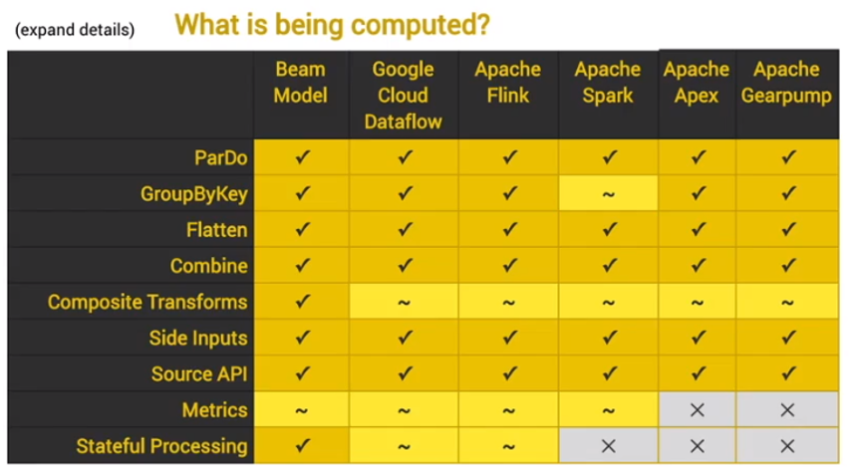
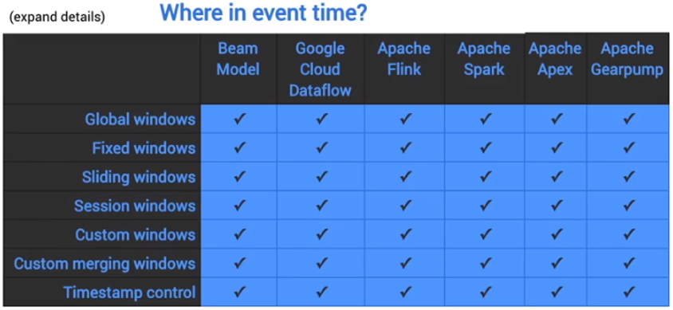
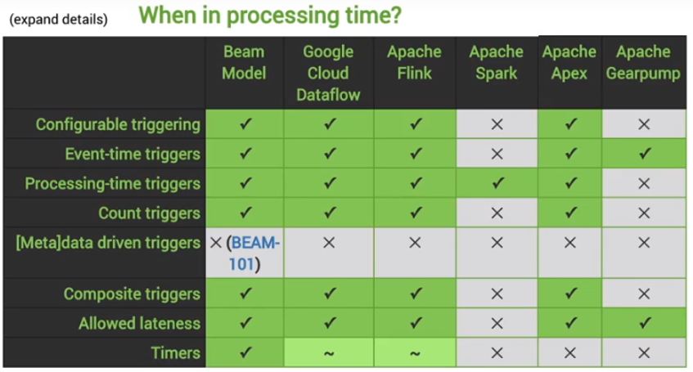
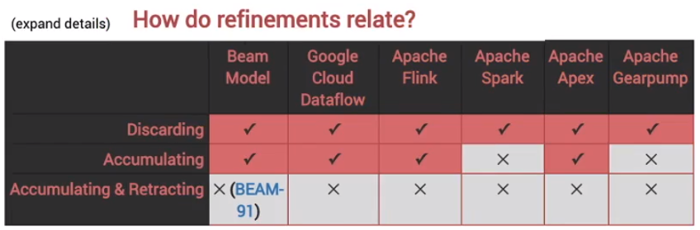
Trigger = Determine when results in window are emitted (submitted depends on type).
Allow to handle late data with advanced trigger (java only at this moment)
Timestamps, element count, multiple causes.

Slide 35
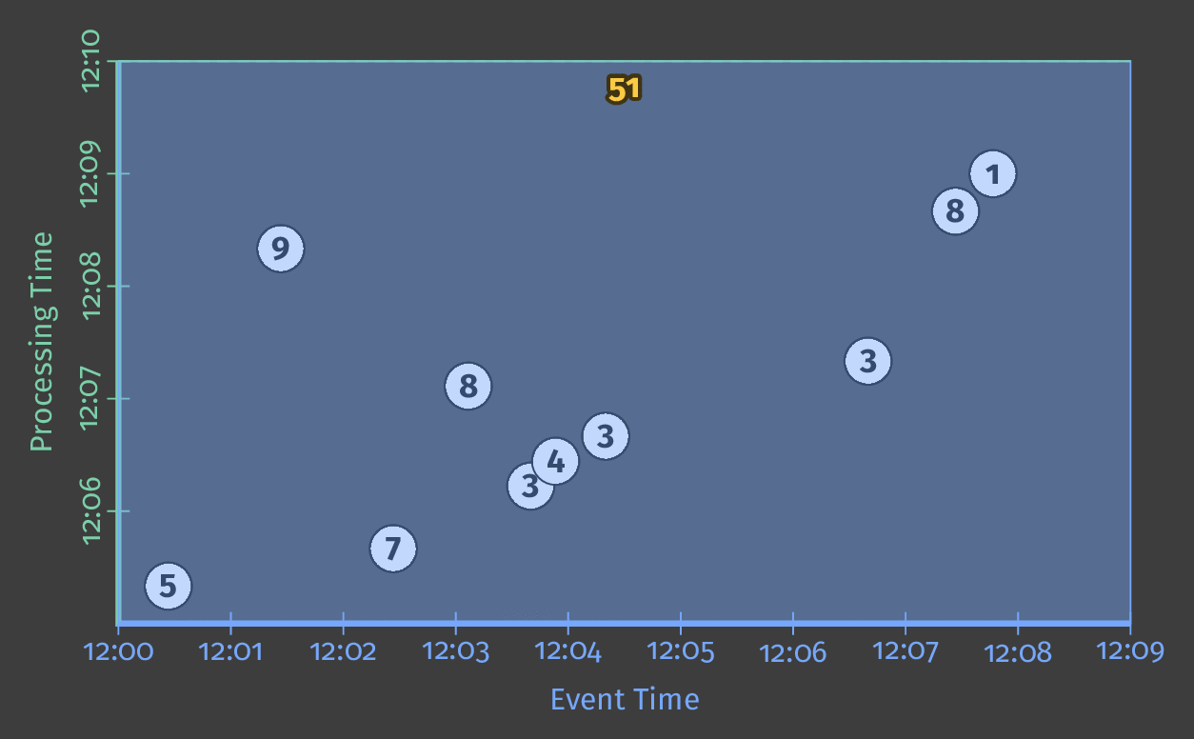
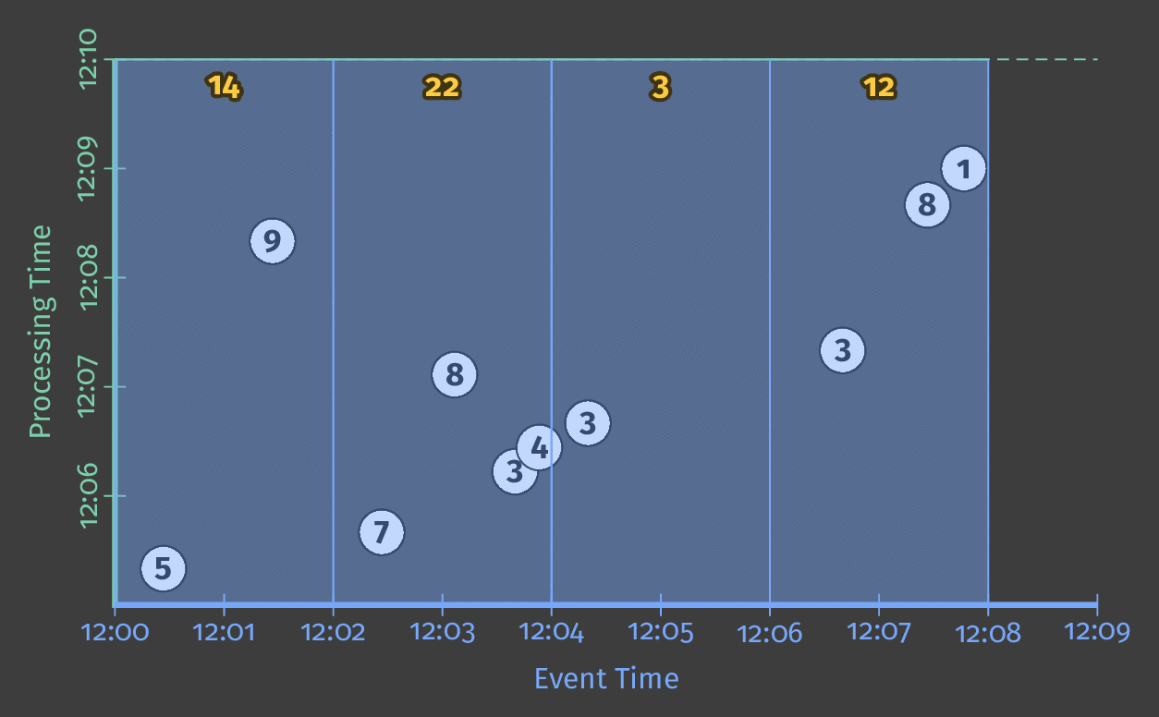
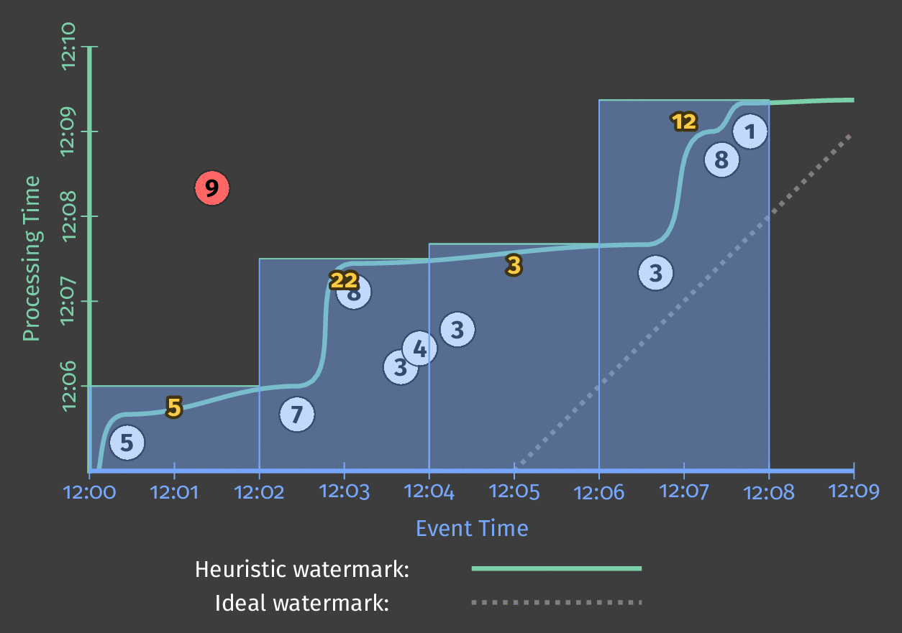
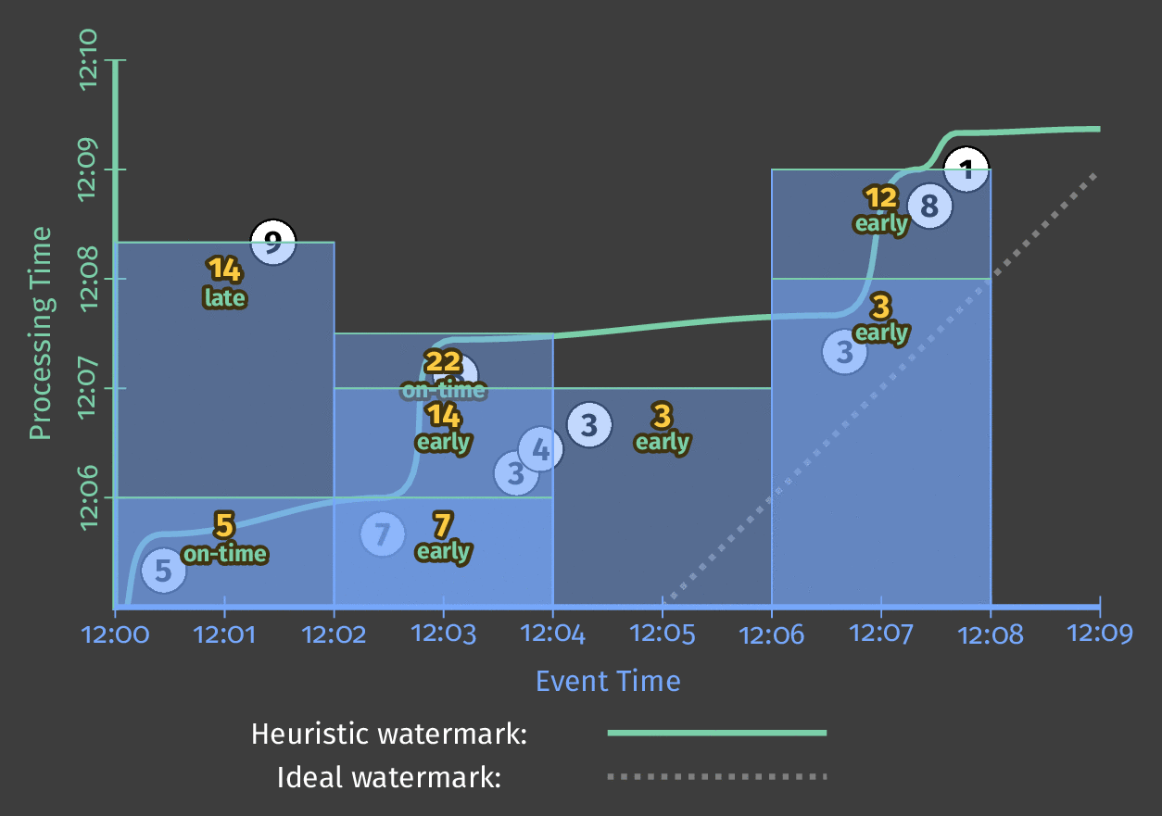
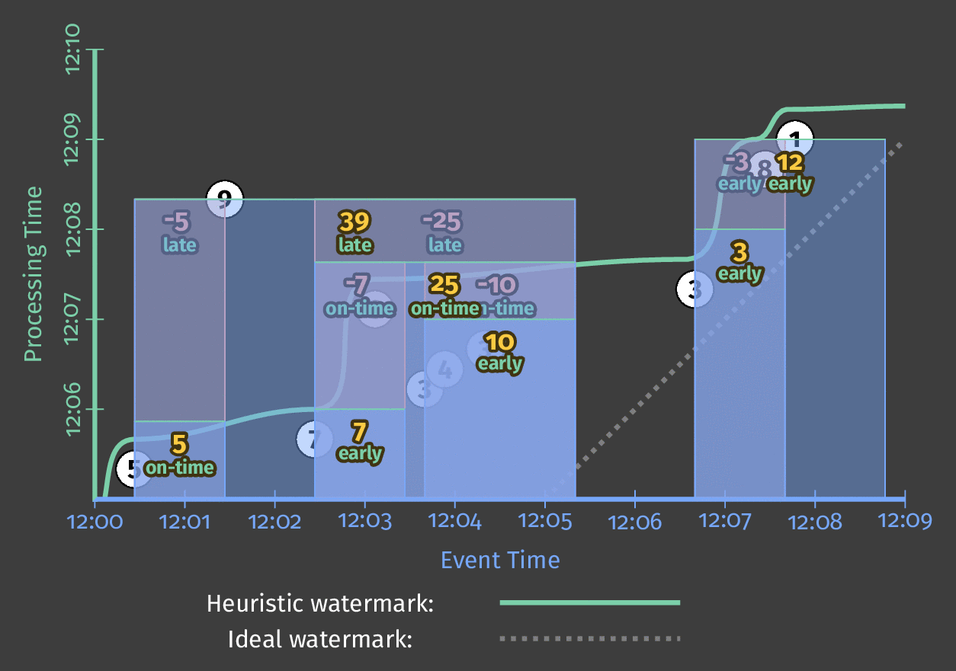
What Where When How
Customizing What When Where How
1.Classic Batch
2. Batch with Fixed Windows
3. Streaming
4. Streaming with Speculative + Late Data
5. Streaming With Retractions
By default time window is unlimited and unique.
Notes:
By tuning our what/where/when/how knobs, we’ve covered a wide spectrum of use cases:
We started with classic batch
Then we divided that up into event-time based windows
We started emitting those windows in a streaming fashion by triggering at the water mark.
We added in speculative and late data with a more advanced trigger
And finally, we went totally bonkers with sessions and retractions
And all throughout this -- we didn’t change our core algorithm at all.

Slide 36
Cloud Dataproc

Slide 37
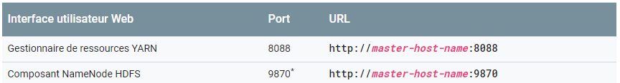
Dataproc | Fast provisioning Managed hadoop + spark (ideal if you bring hadoop releated stuff) Gobal or regional Includes: Hadoop (MapReduce,YARN,HDFS), Spark, Hive and Pig. « No-ops » : create cluster, use it, turn it off. Use Google Cloud Storage, not HDFS – else billing will hurt. Ideal for moving existing code to GCP. Worker nodes all have the same configuration. 3 modes: Single node (1 master, 0 workers), Standard (1 master, N workers) & High Availability (3 masters, N workers).
Cluster machine types | Built using Compute Engine VM instances Cluster – Need at least 1 master and 2 workers Preemptible instances (processing only) – OK if used with care
Preemptible VMs | No preemptible-only clusters – at least 2 non-premptible workers will be added automatically. Minimum persistent disk size – smaller than 100 GB and primary worker boot disk size (for local caching – not part of HDFS) We can use –graceful –decommission –timeout 300 (sec/m/d) to do this gracefuly decommission it.(max 1d)
Initialisation Actions | Can specify scripts to be run from GitHub or Cloud Storage. (e.g install kafka) Can do so via GCP console, gcloud cli or programmatically. Run as root (i.e no sudo) Use absolute paths Use shebang line to indicate script interpreter. Only when you create a cluster, you can specify custom properties with conf. files (hdfs,jive,spark…)
Secure access | You can configure SOCKS proxy to access via your local browser. SSH Using web browser (cloud shell) with port config.

Slide 38
High Availability | While Dataproc cluster creation specify « high availability » configuration. Will run 3 masters rather than 1. The 3 masters will run in an apache Zookeeper cluster for automatic failover.
Single node clusters | Just 1 node – master as well as worker. Can’t be a preemptible VM. Use for prototyping, educational use etc.
Restartable Jobs | By default, Dataproc jobs do not restart on failure. Can optionally change this – useful for long-running and streaming jobs (eg Spark streaming) Mitigates out-of-memory, unscheduled reboots.
Connectors | BigQuery BigTable (Hbase API) Cloud Storage
IAM | Viewer and editors can view and edit : clusters jobs and operations. Worker have full access to : Agents, tasks, Logging, monitoring and storage. You can use a service account to give rights to GS and uses special service accounts when you create a new cluster. At a minimum, service accounts used with Cloud Dataproc need permissions to read and write to Google Cloud Storage, and to write to Google Cloud Logging.
Monitoring | Dataproc console or Stackdriver monitoring. Stackdriver logging for dataproc audit logs and messages from Hadoop.
Upgrading | Can only change #Workers/preemptible VM’s/labels/toggle graceful decommissioning (to finish work in progress on a worker before it is removed) Automatically reshards data for you Gcloud dataproc clusters update [cluster_name] –num-workers [#] –num-preemptible-workers [#] Scaling even jobs are running : Add workers, Remove workers and Add HDFS storage
Migration from on-premise | Move data first to GSC with connectors. Hbase to BigTable, Impala to BQ or move this in GCS if no features needed. Test a little sample for POC. Think as ephemeral (decouple computing and data eg: store in GCS/ Big table/ Big Query ) Shutdown clusters when not used and use preemptible VMs.

Slide 39
Machine & deep learning

Slide 40
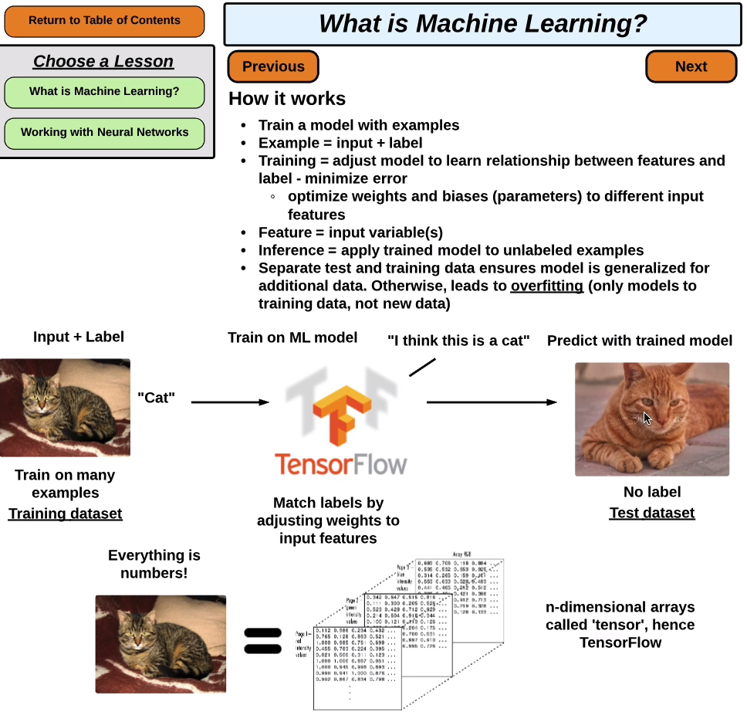
Machine Learning
Definition | Process of combining inputs to produce useful predictions on never-before-seen data. Makes a machine learn from data to make predictions on future data, instead of programming every scenario.
Learning types | Supervised learning (labels) : Apply labels to data (« cat », « spam » ) Regression – continous, numeric variables: Predict stock price, student test scores Classification – categorical variables: Yes/no, decision tree « is this email spam ? »; « is this picture a cat ? Same types for dataset columns : Continuous (régressions) and categorical (classification) Income, birth year = continuous Gender, country = categorical Unsupervised learning (patterns) : Clustering – finding patterns Not labeled or categorized « given the location of a purchase, what is the likely amount purchased ? » Heavily tied to statistics Reinforcement learning (positive or negative reinforcement to achieve a goal) : Use positive/negative reinforcement to complete a task Complete a maze, learn chess

Slide 41
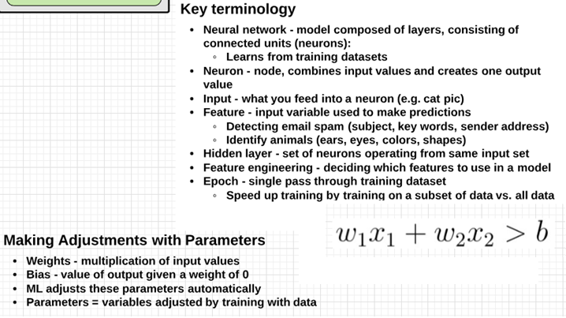
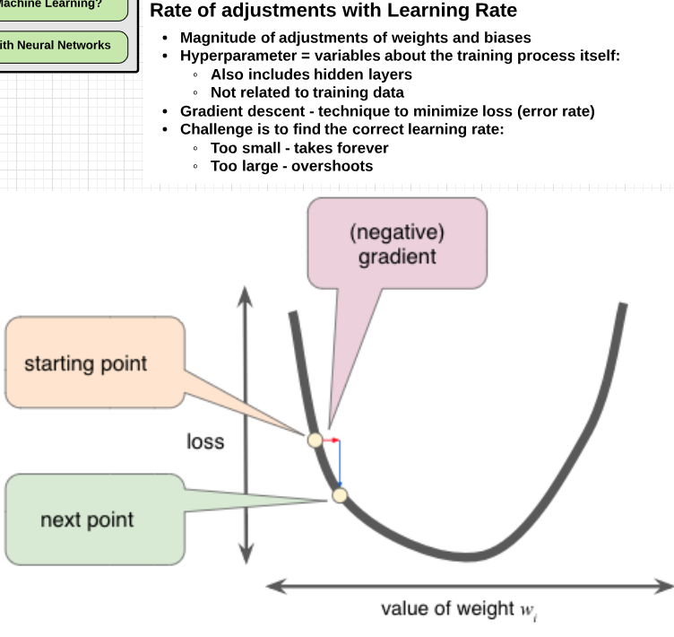
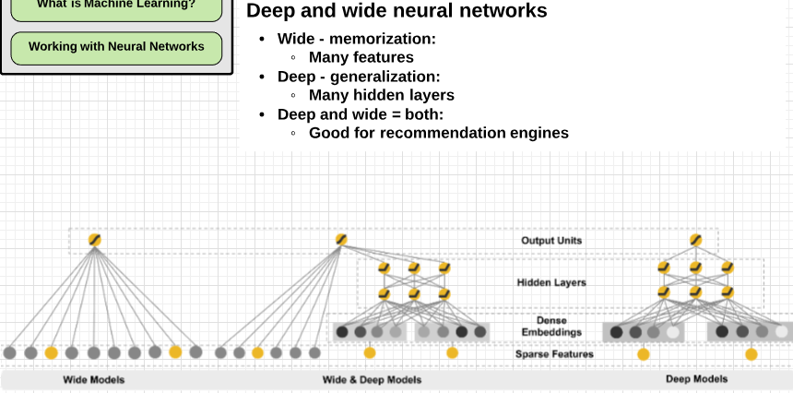
Neural Networks
and learning rates.
(e.g -0,40 ot 0.90 )
(mesure the difference between training and testing points in ML curve)

Slide 42
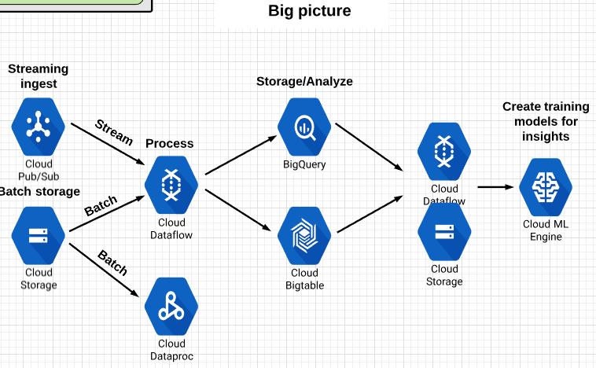
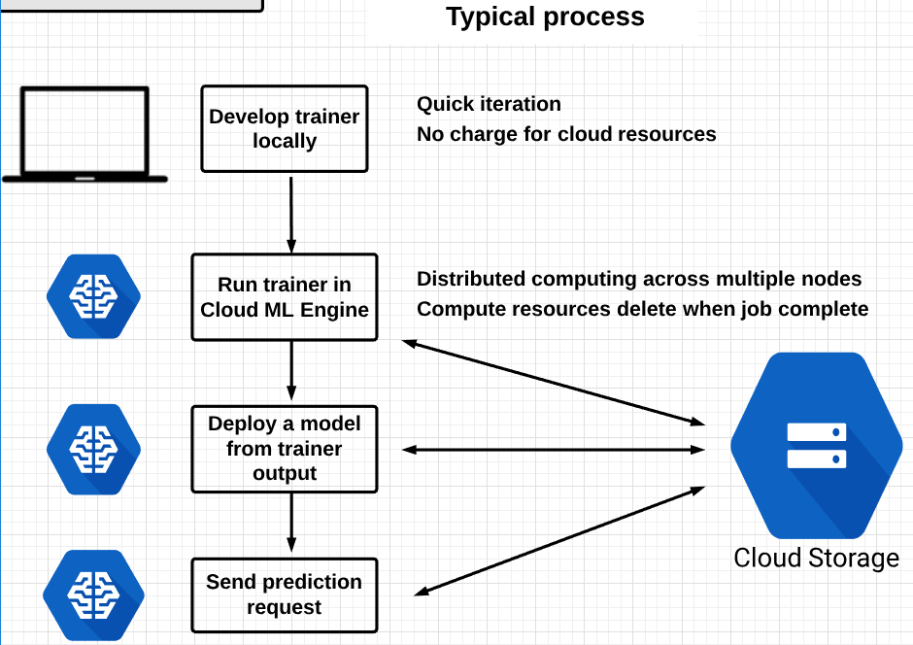
ML engine

Slide 43
ML engine
Google ML | Tensorflow (high performance numerical cumputation, open source for Pre-processing,feature creation and model training) Cloud ML engine (supports : Tensorflow, scikit-learn, XGBoost frameworks and Keras in beta) Pre-build API’s
Cloud ML | Fully managed tensorflow Distributed training and prediction Scales to tons of CPU’s/GPU’s/TPU’s Hyperparameter tuning with hypertune (hptuning_data.yaml) Automate the annoying bits of machine learning.
ML Api’s | Pre-built machine learning models.
Howto ML engine : 1-Prepare and train on-premise | Write training application in TF. Python is a language of choice. Run training model on local machine. (gcloud ml-engine local train) | Terminology: Model – logical container individual solutions to a problem: Can deploy multiple versions Eg. Sale price of houses Version – instance of a model Eg. Version 1/2/3 of Sale price house Job – interactions with Cloud ML Engine : Train models Command = ‘submit job train model’ on Cloud ML Engine Deploy trained models Command = ‘submit job deploy trained model’ on Cloud ML Engine ‘Failed’ jobs can be monitored for troubleshooting.
2-Train with cloud ML | Train model with cloud ML engine: Training service allocates resources by specification (cluster of resources) Master – manages other nodes Workers – works on portion of training job Parameter servers – coordinates shared model state between workers Package model and submit job Package application and dependencies
3-Get predictions (2 types) | - Online: High rate of requests with minimal latency Give job data in JSON request string, predictions returned in its response message - Batch: Get inferance (predictions) on large collections of data with minimal job duration Input and output in cloud storage

Slide 44
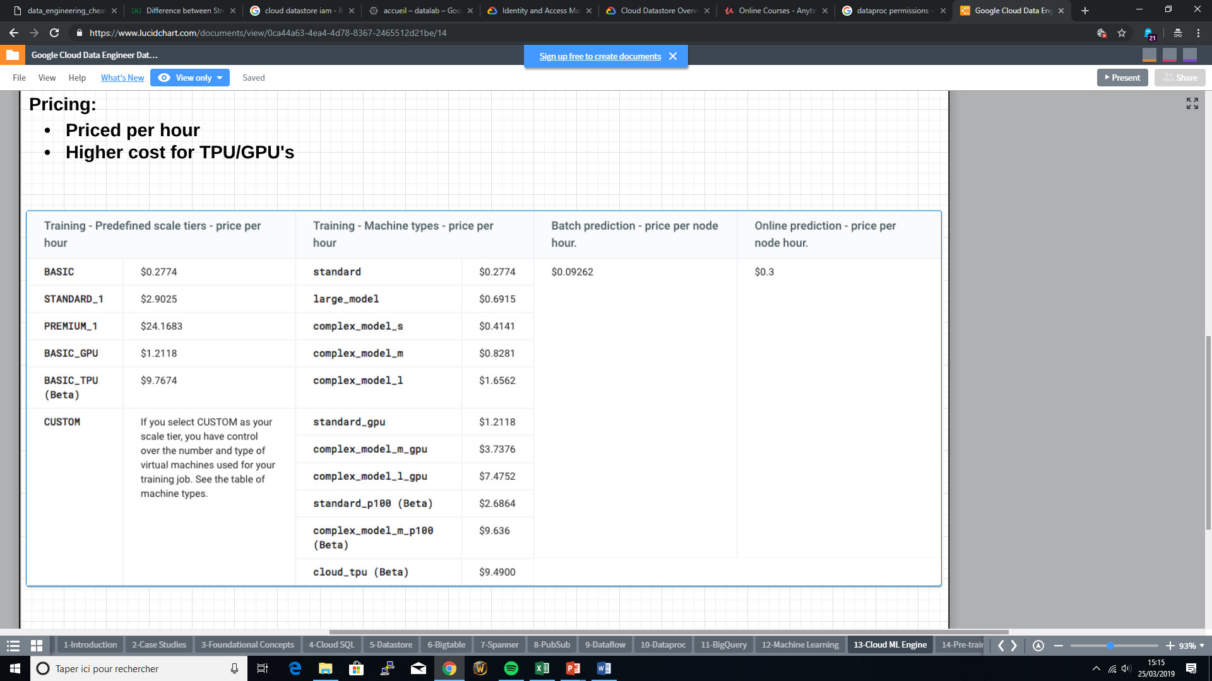
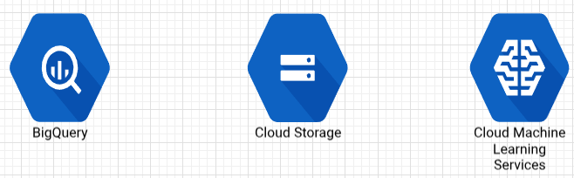
ML engine
IAM | @ Project and models: Admin – Full control Developper – create training/prediction jobs, models/versions, send prediction requests Viewer – read-only access to above Models only: Model owner: Full access to model and versions Model User: Read models and use for prediction Easy to share specific models
Usage with BQ | Using BQ for data source : Can read directly from BigQuery via training application Recommended to pre-process into Cloud Storage Using gcloud commands only works with Cloud Storage
Pricing | Training predefined scale tiers Custom choose also TPU(beta) + standard CPU/GPU

Slide 45
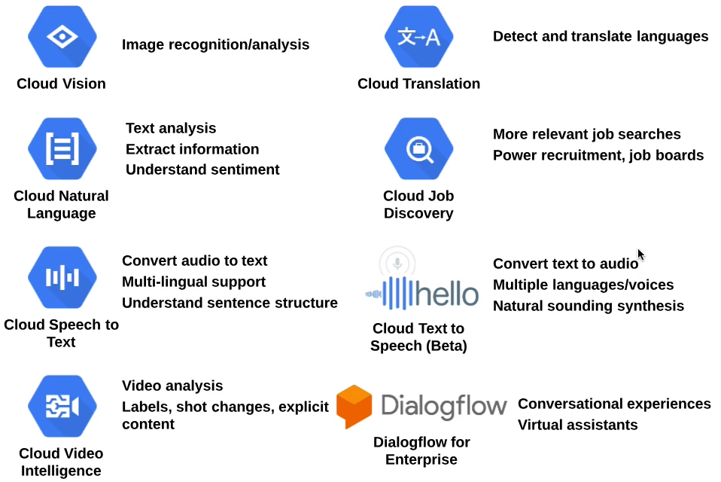
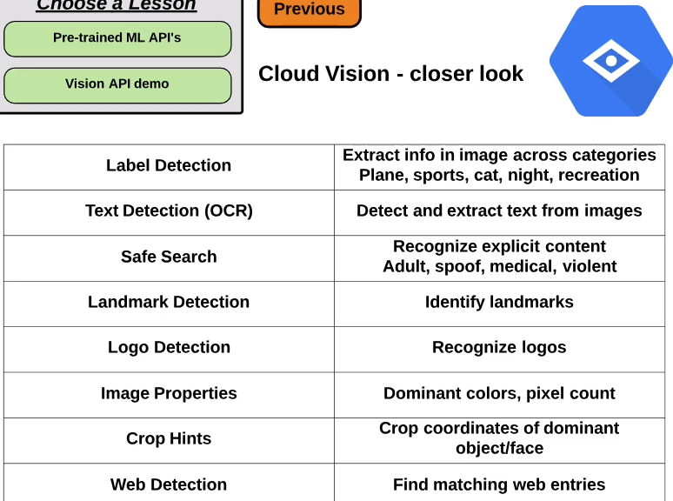
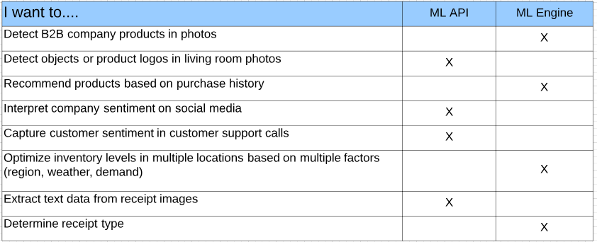
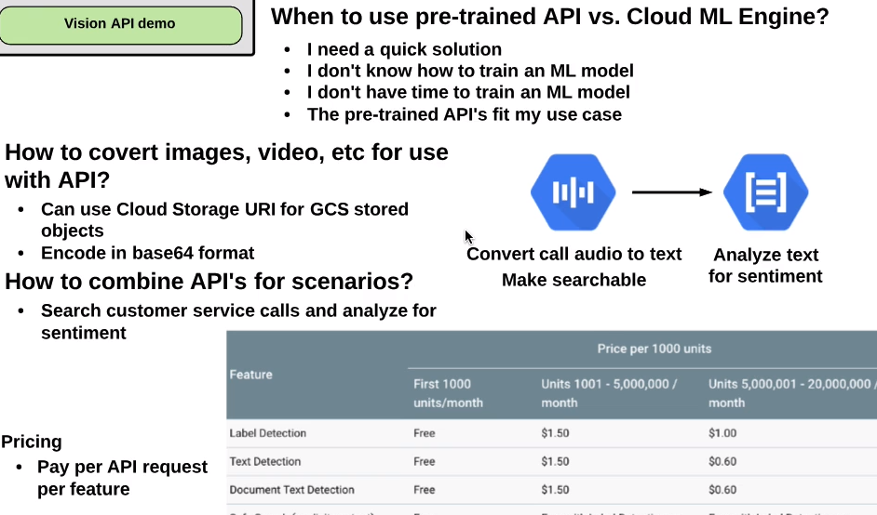
Pre trained ML API

Slide 46
Stackdriver

Slide 47
Stackdriver Google owned company
Hosting projects holds the monitoring configuration for GCP and AWS and the Stackdriver account : Single monitoring = create account in the same project. Multi monitoring = create a dedicated project for monitoring. Basic (no stackdriver account) is free with 5 GB cap Retention period depends on notifications complexity depends on the service tier.
Service | Description
Monitoring | Collect metrics,events…. (Cpu,MEM,Custom…) from multiple GCP projects and AWS accounts during 6 weeks.
Debugger | Stackdriver Debugger lets you inspect the state of a running application, in real time, without stopping or slowing it down at any location in your source code
Trace | Distributed tracing system that collects latency data for near real-time performance insights. (e.g. VMs, containers, or Google App Engine projects)
Logging | Store, search, analyze, monitor, and alert on log data and events (apps and VMS) from Google Cloud Platform and Amazon Web Services (AWS). Sinks : Cloud Storage bucket, a BigQuery dataset, or a Cloud Pub/Sub topic.
 | Log types Audit logging, Admin activity(by default), Data access logs and BQ access logs(by default). | Using logs: Monitoring anything Create log metrics to view in Stackdriver monitoring.
Error | A centralized error management interface counts, analyzes and aggregates the crashes

Slide 48
Case study

Slide 49
Flowlogistic
Main themes : Transition existing infrastructure to cloud Reproduce existing workload (« lift and shift »): First step into cloud transition
Primary cloud objectives : Use proprietary inventory-tracking system: Many IoT devices – high amount of real-time (streaming) data Apache kafka stack unable to handle data ingest volume Interact with both SQL and NoSQL Databases Map to Pub/Sub – dataflow: Global, scalable Hadoop analytics in the cloud: Dataproc – managed hadoop Different data types Apply analytics/machine learning
Other technical considerations : Emphasis on data ingest: Streaming and batch Migrate existing workload to managed services: SQL – Cloud SQL: Cloud Spanner if over 10 TB and global availability needed Cassandra – NoSQL (wide-column store) – Bigtable Kafka – Pub/Sub, Dataflow, BigQuery Store data in a ‘data lake’: Further transition once in the cloud Storage = Cloud Storage, BigTable, Big Query Migrate from HDFS
https://cloud.google.com/certification/guides/data-engineer/casestudy-flowlogistic

Slide 50
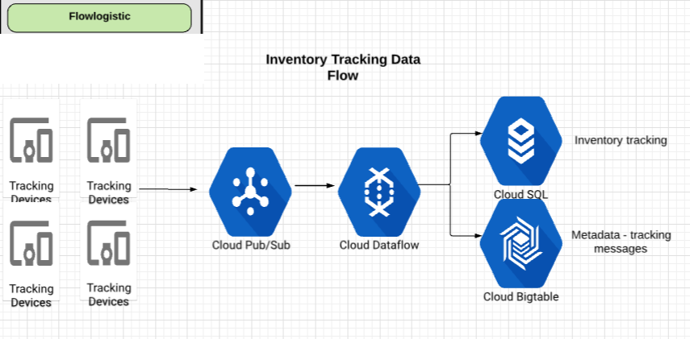
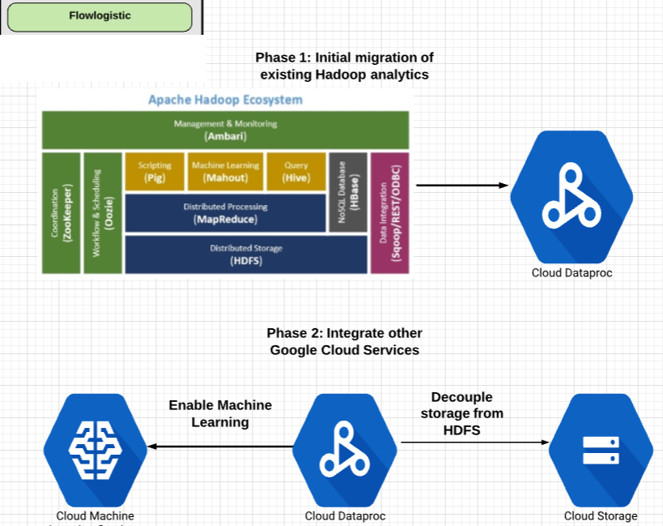
Flowlogistic
IoT Stack
Pub/Sub is used for streaming (real-time) data ingest. Alows asynchronous (many-to-many) messaging via published and subscribed messages.
Dataflow is a data processing pipeline transforming both stream and batch data.
Cloud SQL is a fully managed MySQL/PostgreSQL database. It is a perfect transition step for migrating SQL workloads.
Cloud Bigtable is a managed columnar database, massively scalable non-relational/NoSQL database based on Hbase.
Analytics stack
Cloud Dataproc offers fully managed Hadoop, and Spark cluster managment. It integrates easily with other GCP services.
Managed Machine learning services for predictive analytics.
Cloud Storage, provides globally available, long-term, high-performance storage for all data types.

Slide 51
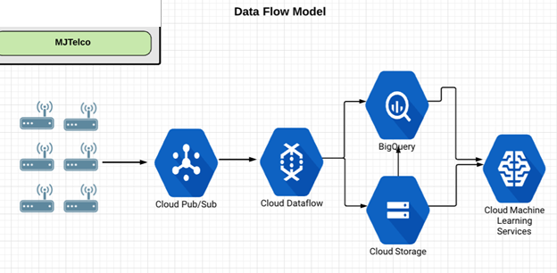
MJTelco
Main themes : No legacy infrastructure – fresh approach Global data ingest
Primary cloud objectives : Accept massive data ingest and processing on a global scale: Need no-ops environment Cloud Pub/Sub accepts input from many hosts, globally Use machine learning to improve their topology models
Other technical considerations : Isolated environments: Use seperated projects Granting access to data: Use IAM roles Analyze up to 2 years worth of telemetry data: Store in Cloud Storage or BigQuery
https://cloud.google.com/certification/guides/data-engineer/casestudy-mjtelco
Pub/Sub is used for streaming (real-time) data ingest. Alows asynchronous (many-to-many) messaging via published and subscribed messages.
Dataflow is a data processing pipeline transforming both stream and batch data.
Cloud Storage, provides globally available, long-term, high-performance storage for all data types.
Big Query is no-ops data warehouse used for massively scalable analytics.
Managed Machine learning services for predictive analytics.

Slide 52
Annexe

Slide 53
Dataprep

Slide 54
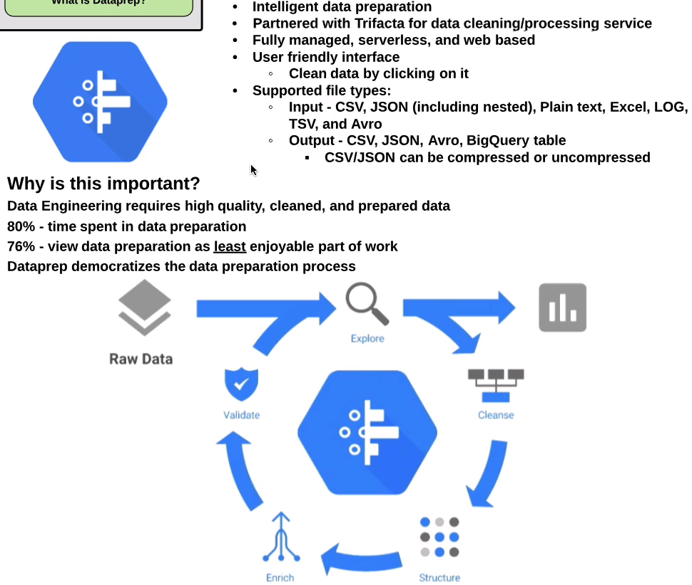
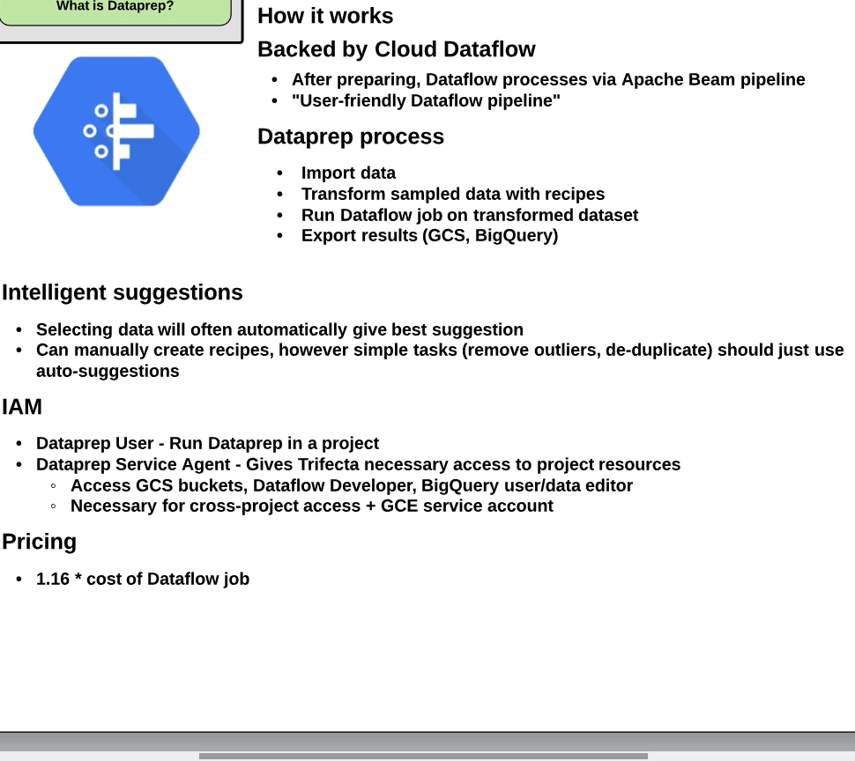
Dataprep

Slide 55
Datalab

Slide 56
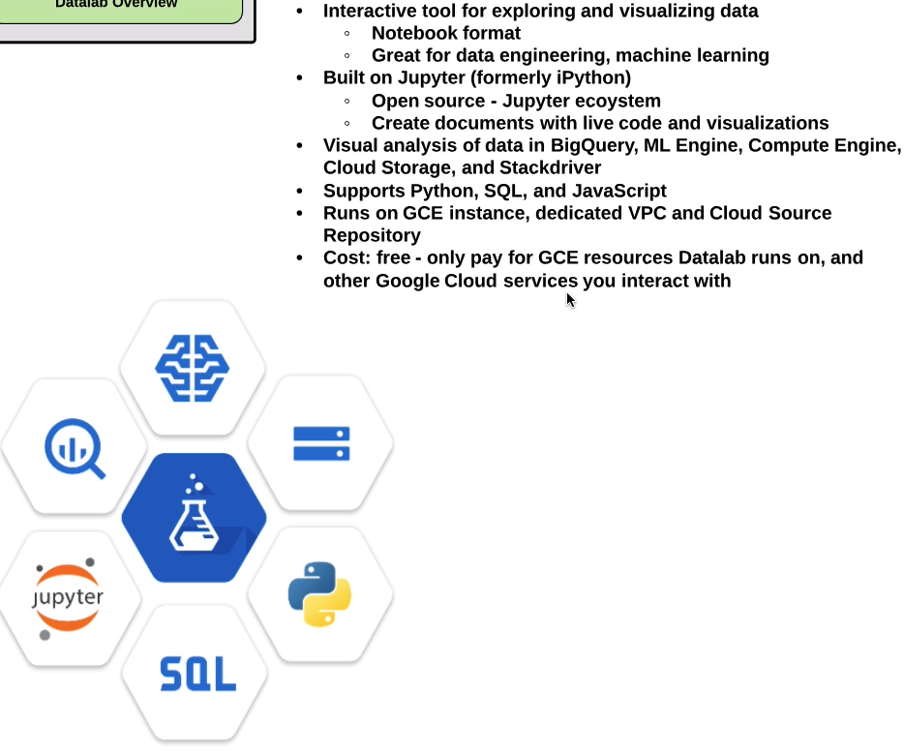
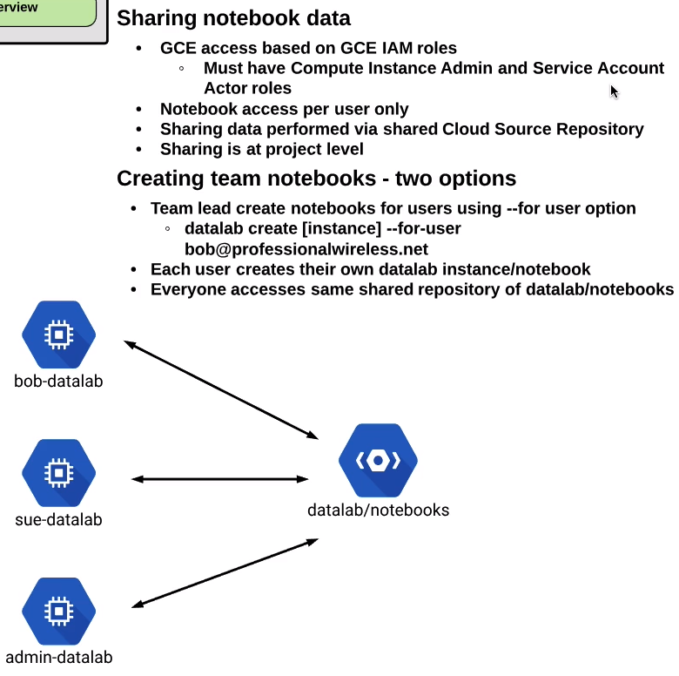
Datalab

Slide 57
Datalab
Cloud shell | Datalab create <instancename> -> then click web preview and change port.
Notebooks | Better than text files for code Include code, documentation (markdown), results. Results can be text, images, HTML/Javascript. Notebooks can be in Cloud Storage Repository (git repository).
Presistent disk | Notebook can be cloned from cloud storage repository to VM persistent disk This clone => workspace => add/remove/modify files Notebookks auto-saved, but if persistent disk deleted and code not committed to git, changes will be lost.
Service account | Code can access BigQuery, autoML etc … using service account. Service account needs to be authorized accordingly.
Kernel | Opening a notebook => backend kernel process manages session and variables Each notebook has 1 python kernel – if N nootebooks, then N processes Kernels are single-threaded Memory usage is heavy – execution is slow – pick machine type accordingly
Connection to datalab | Gcloud SDK: running the container in a compute engine VM and connecting to it through a ssh tunnel. Cloud Shell: running the docker container in a compute engine VM and connecting to it through Cloud Shell. Local Machine: running the Docker container on your local machine (must have docker installed).

Slide 58
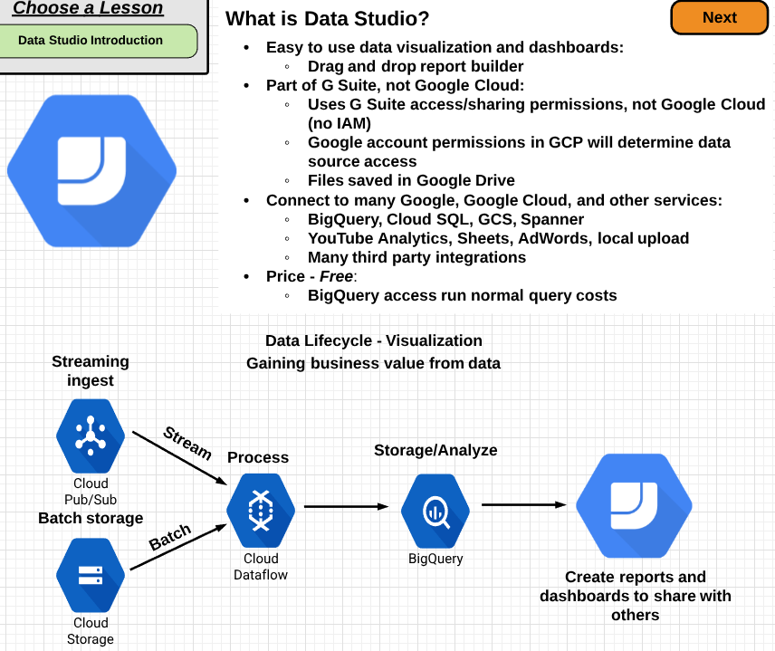
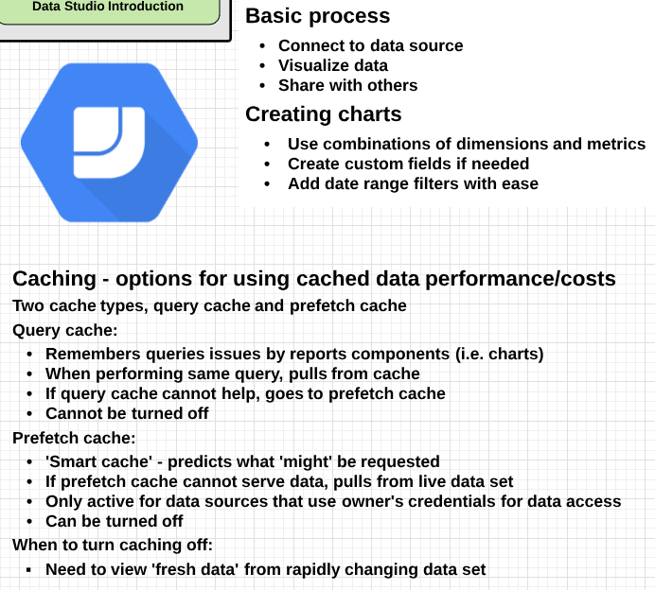
Datastudio

Slide 59
Commands :
Gsutil mb –c regional –l asia-east1 gs://loony-asia-bucket
make bucket create regional location asia east name gs://loony-asia-bucket
Gcloud compute region list
List all the gcp regions availables
Gsutil ls
List all buckets
Gsutil cp –r –p gs://loony-asia-bucket/* gs://loony-asia-bucket/
Copy recursivly with all the permissions the source to destination
Gsutil lifecycle get bucketname
To check if there is a lifecycle policy on a bucket
Gsutil lifecycle set lifecycle_policy_file bucketname
We can set automaticaly deletions of items after 30 days for exemple
Gsutil –L –b gs://loony-asia-bucket/
Gsutil list the bucket properties

Slide 60
